Slide 1
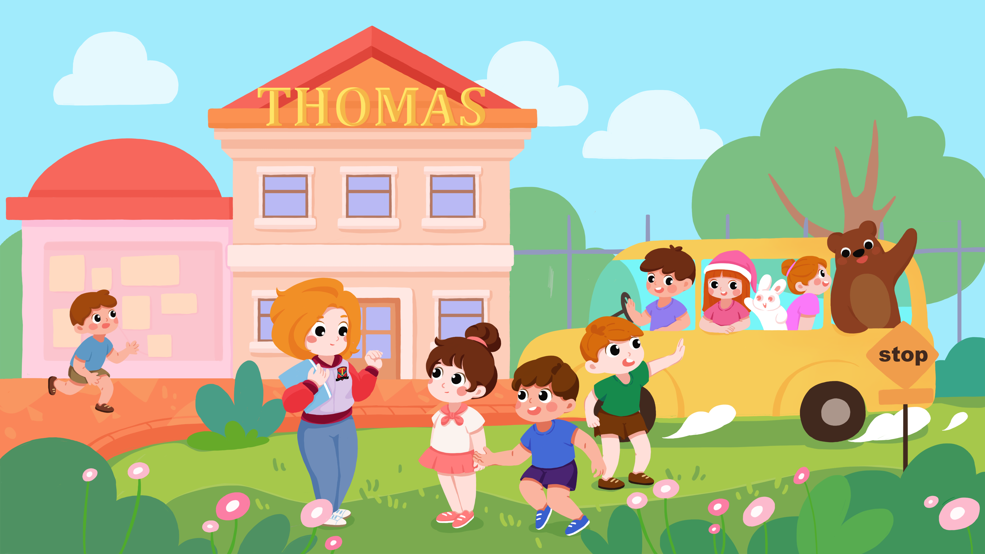


Slide 2


Teaching objective
Grammar:
What’s your name?
My name is ….
Thomas Iris Ben Lily
Notes:
Tips： T should preview the contents of this lesson and prepare all the items you need in the class.

Slide 3

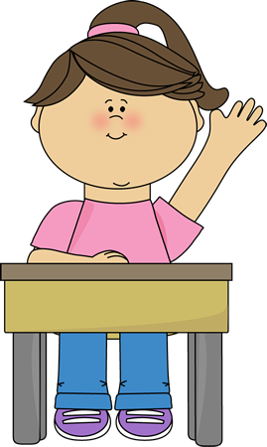

Classroom Rules
Eyes on me.
Hands up.
Sit well.
Notes:
Tips: T should introduce the classroom rules before the lesson. Lead the kids to obey the rules.

Slide 4

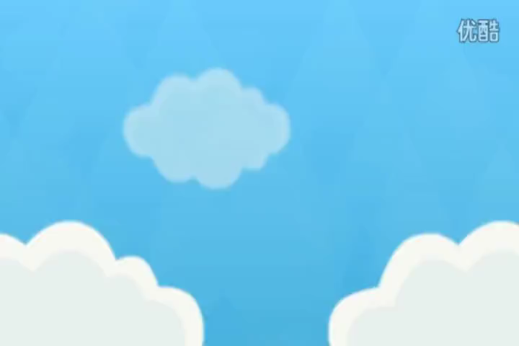
Warm-up
Notes:
Tips: 1. T leads the kids to listen to the song carefully. 2. Lead the kids to stand up and sing the song with music with actions.
歌曲需要编辑，覆盖掉logo，或者贴上Thomas的logo

Slide 5




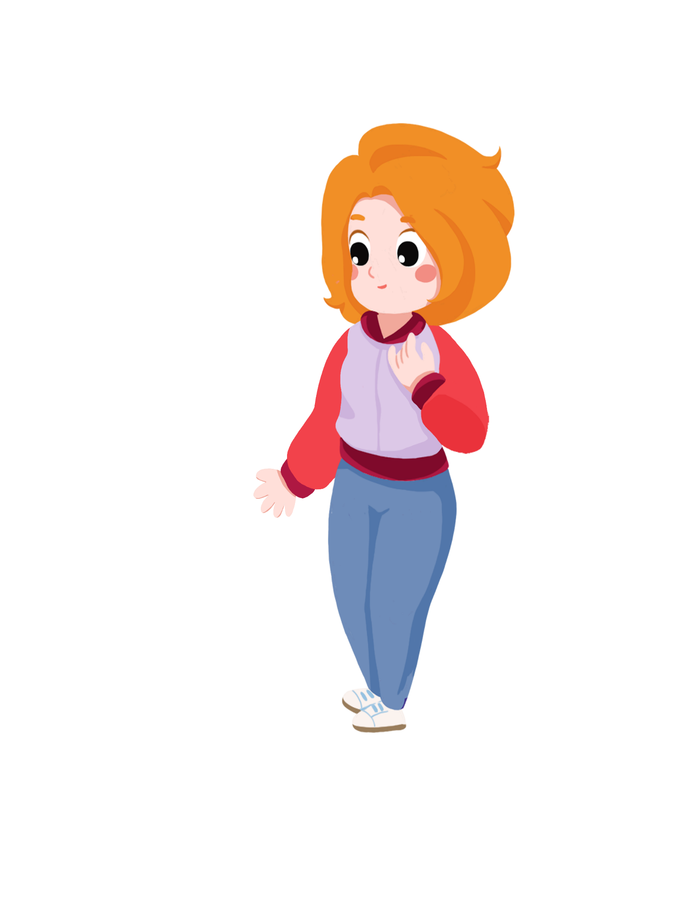
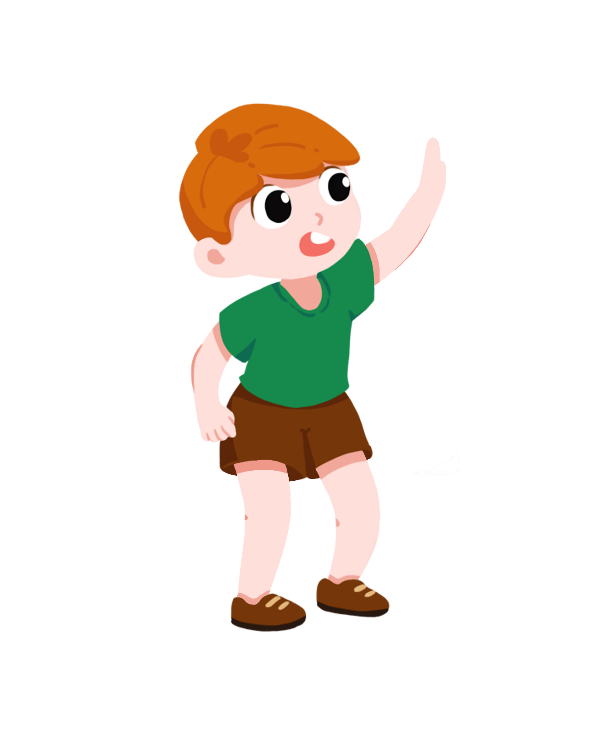

Review
T Says, Ss Say 1min
Good morning, Thomas.
Good morning, Lily.
Good morning, teacher.
Good morning, teacher.
Notes:
Tips: 1. Watch the slide carefully. 2. T says the words, Ss need to follow the T. Read the words for 3 times. (T can read the words in different ways: clapping hands/ high and low voice/ change the voice )

Slide 6



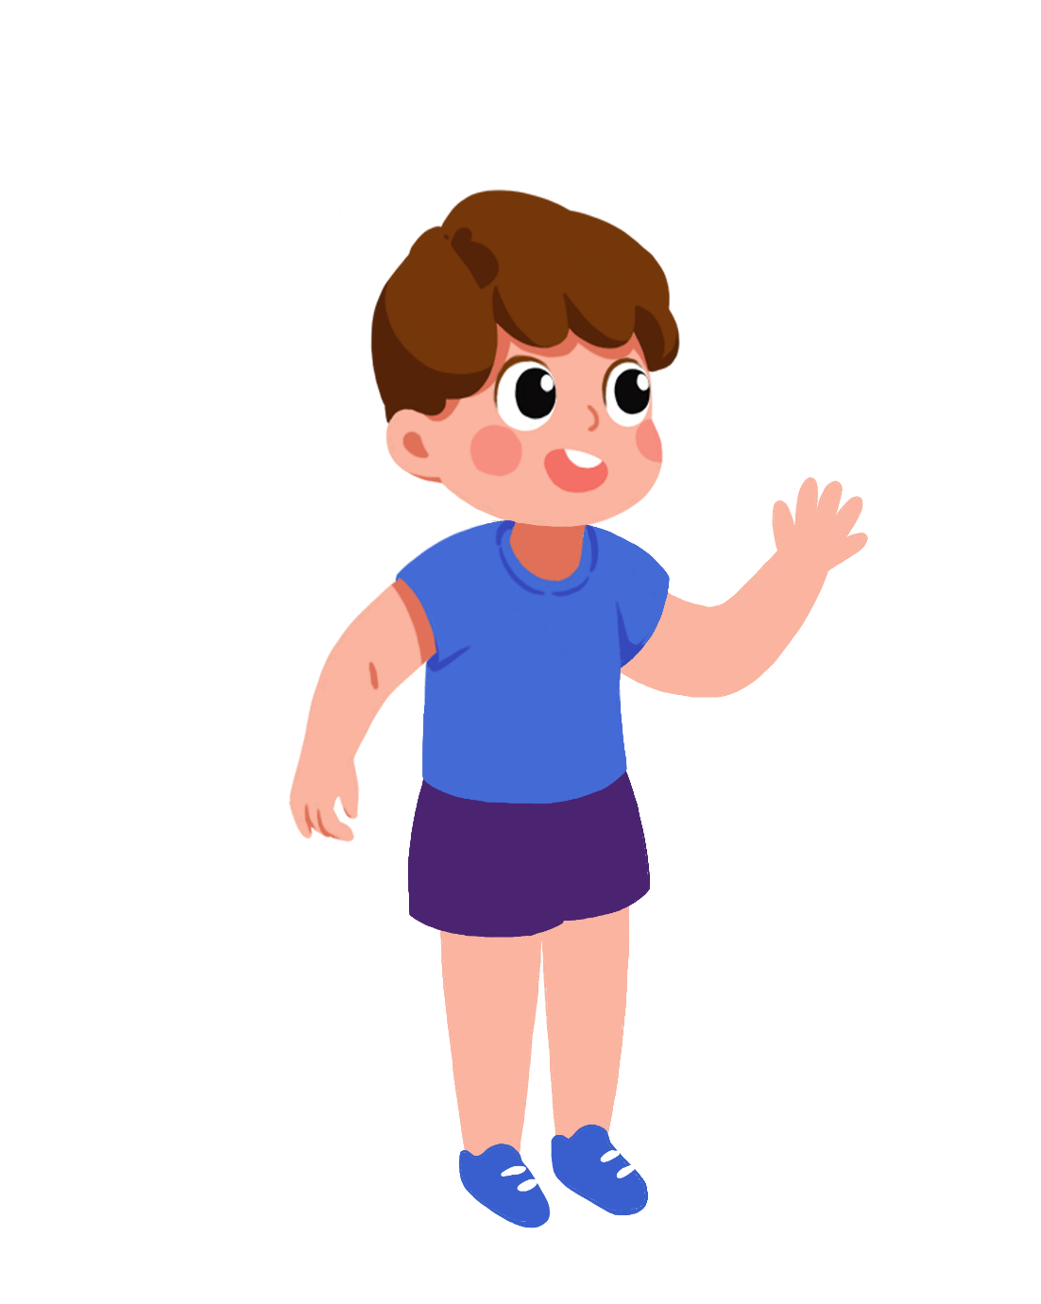
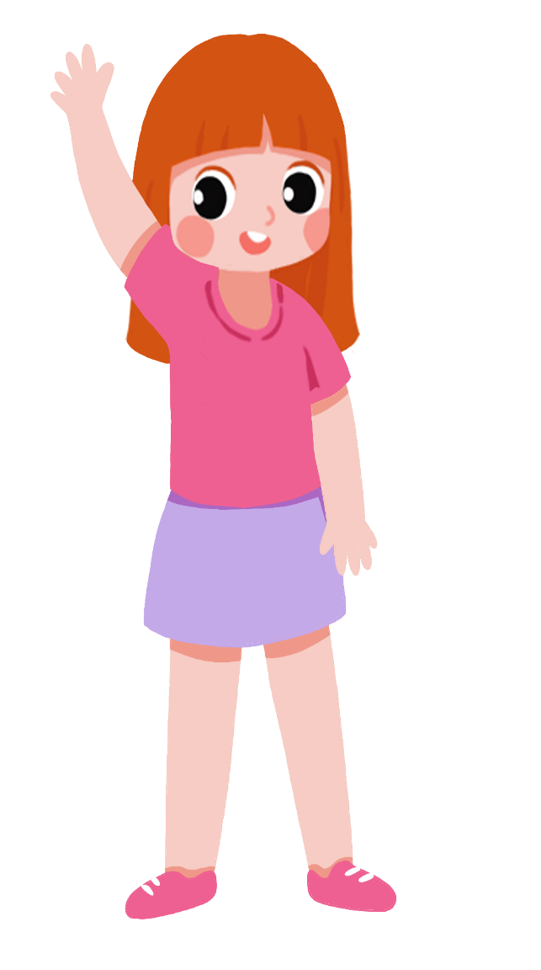
Review
T Says, Ss Say 1min
Good afternoon, Iris!
Good afternoon, Ben!
Good afternoon, teacher!
Good afternoon, teacher!
Notes:
Tips: 1. Watch the slide carefully. 2. T says the words, Ss need to follow the T. Read the words for 3 times. (T can read the words in different ways: clapping hands/ high and low voice/ change the voice )

Slide 7


Practice
Performance two kids one group 3min
Good morning, Thomas!
Good morning, Lily!
Notes:
Tips: 1. Divide the kids into several teams. Two kids one team. Ask the kids to have a performance with the sentences kids have learnt.

Slide 8

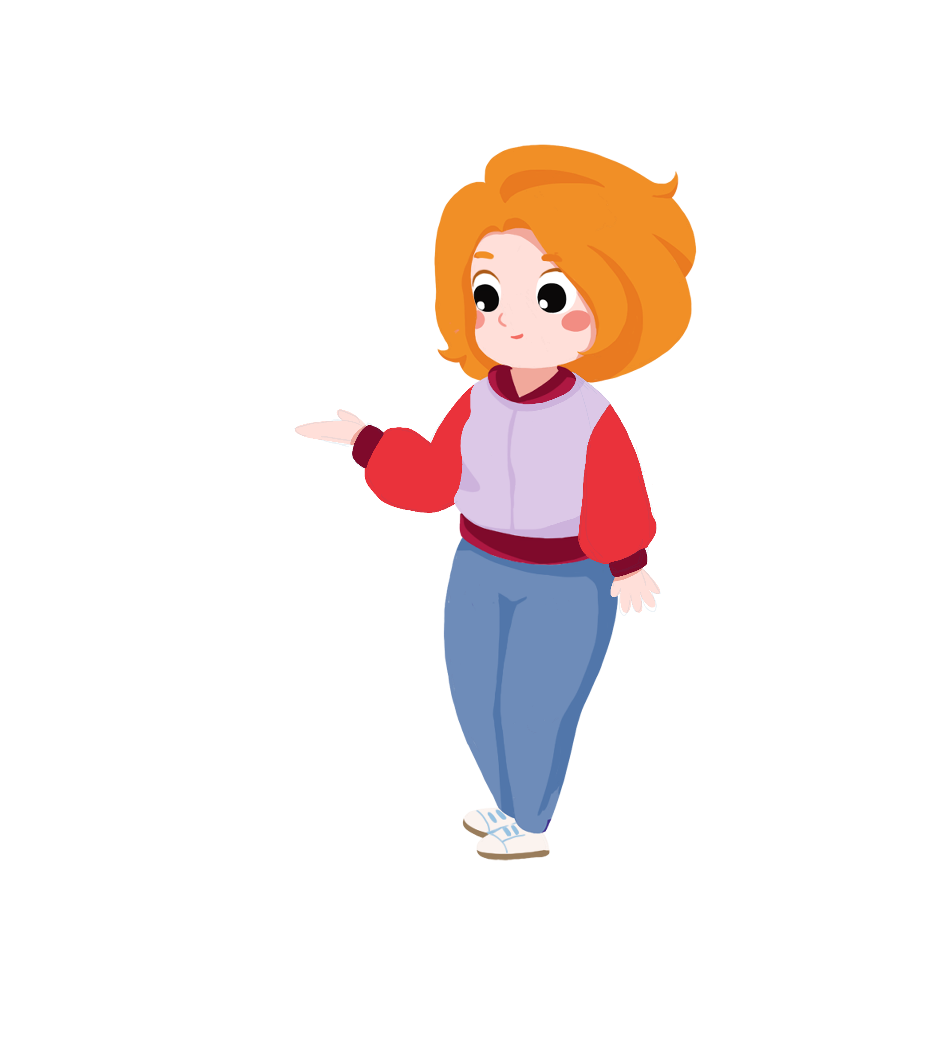

Intro
T lectures and asks 1 min
Hello, my name is Linda.
What’s your name?
Notes:
Tips: T perform the scene. And introduce the sentences. Lead in the topic sentence.

Slide 9

Learn
T lectures and asks 1 min
What’s you name?
My name is Thomas.
My name is Lily.
Notes:
Tips: 1. T describe the picture and lead the kids to watch the slide carefully. 2. T reads the sentences, Ss copy. 3. T Performs the scene with the kids selected. 4. Make sure that the kids can obtain the names and identify the characters correctly.

Slide 10


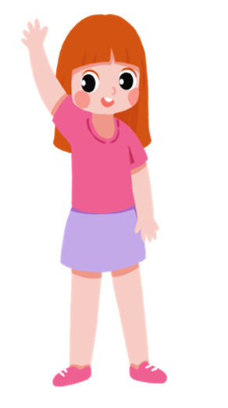
Learn
T lectures and asks 1 min
What’s you name?
My name is Ben.
My name is Iris.
Notes:
Tips: 1. T describe the picture and lead the kids to watch the slide carefully. 2. T reads the sentences, Ss copy. 3. T Performs the scene with the kids selected. 4. Make sure that the kids can obtain the names and identify the characters correctly.

Slide 11

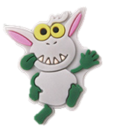






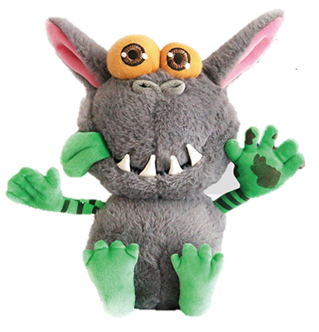





Practice
S listens, chooses and clicks.
Thomas
Notes:
Tips: 1. T introduces the games. 2. T choose one kid. Kid listens to the audio and select out the correct character and click on the right picture. Then read the name out correctly.
添加音频： Thomas

Slide 12
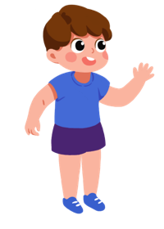
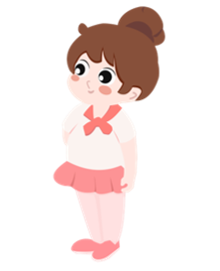
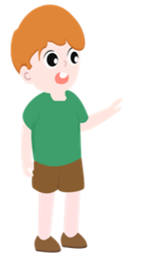
Practice
S listens, chooses and clicks.
Iris
Notes:
Tips: 1. T introduces the games. 2. T choose one kid. Kid listens to the audio and select out the correct character and click on the right picture. Then read the name out correctly.
添加音频： Iris

Slide 13
Practice
S listens, chooses and clicks.
Lily
Notes:
Tips: 1. T introduces the games. 2. T choose one kid. Kid listens to the audio and select out the correct character and click on the right picture. Then read the name out correctly.
添加音频： Lily

Slide 14
Practice
S listens, chooses and clicks.
Ben
Notes:
Tips: 1. T introduces the games. 2. T choose one kid. Kid listens to the audio and select out the correct character and click on the right picture. Then read the name out correctly.
添加音频： Ben

Slide 15

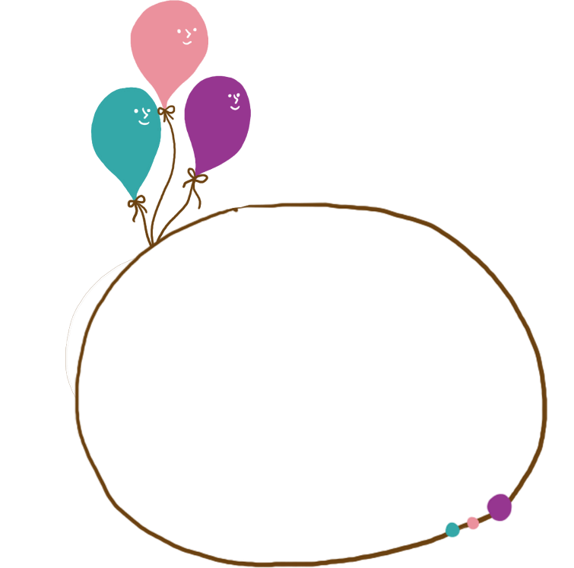




Practice
Click and Answer questions.
Lily
What’s your name?
Thomas
Ben
Notes:
Tips: 1. T chooses one kid. Ask the kid to click on one planet. Then read out the sentences shown correctly.

Slide 16




Practice
S1 clicks and asks, S2 answers
My name is Ben.
What’s your name?
My name is Iris.
What’s your name?
My name is Lily.
My name is Thomas.
What’s your name?
What’s your name?
Notes:
Tips:1. T introduces the game. 2. Choose two kids. Click on the right element and then read the right sentences. One kid has one role.

Slide 17




Practice
Click and Say.
Notes:
Tips: 1. T Introduces the game. 2. Choose one kid to click on the bubbles and say out the words in the bubble.

Slide 18
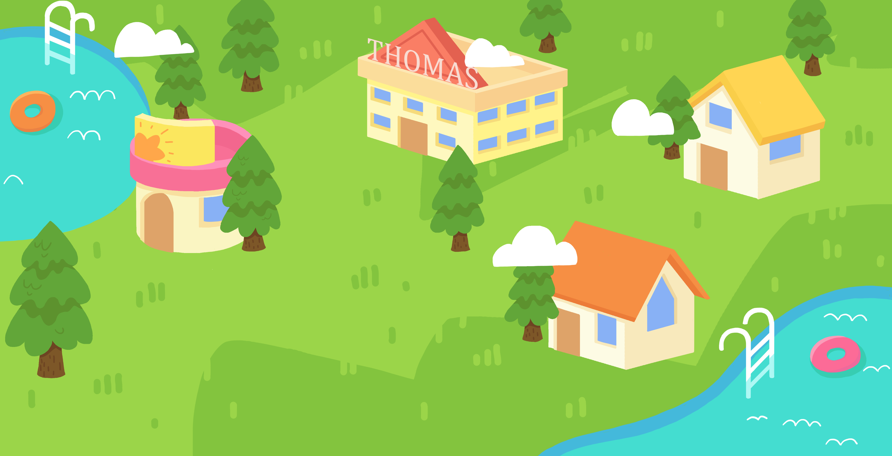









your
name?
What’s
Practice
Click on the boy and Answer questions.
Ben
Lily
Thomas
Iris
Notes:
Tips: 1. T introduces the game. 2. Choose one kid to click on the boy. Then T asks the question, the kid needs to answer the question correctly.

Slide 19

Wrap-up
Click and say.
Words:
Good morning!
Good afternoon!
Good-bye!
teacher
Classmate
Grammar:
What’s your name?
My name is ….
Sentences:
Hello, boys and girls!
Hello, teacher!
Good morning, boys and girls!
Good morning, teacher!

